Slide 2
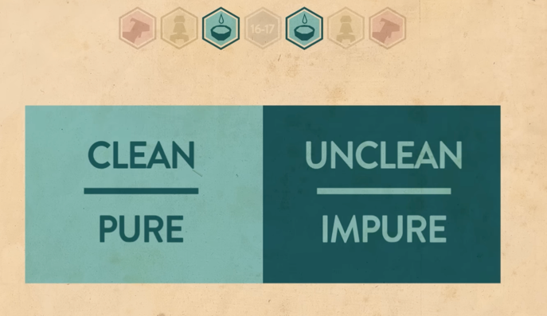
Holy God, Sinful People
“On this day of atonement shall be made for you, to cleanse you; from all your sins you shall be clean before the lord.”

Slide 3
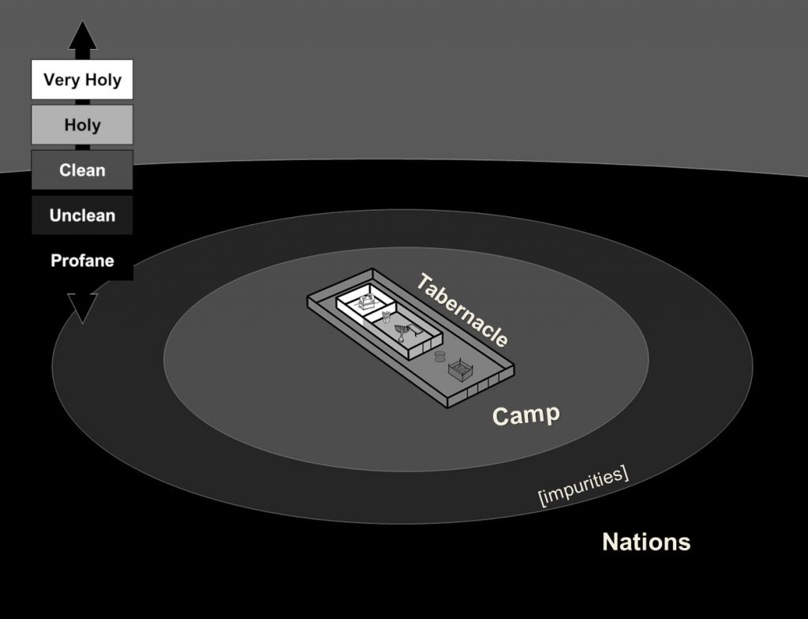

Slide 4
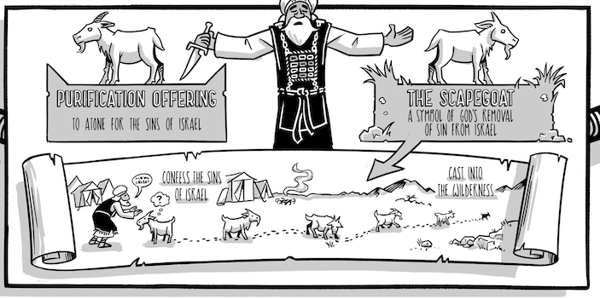
ATONEMENT AND REMOVAL OF SIN

Slide 5
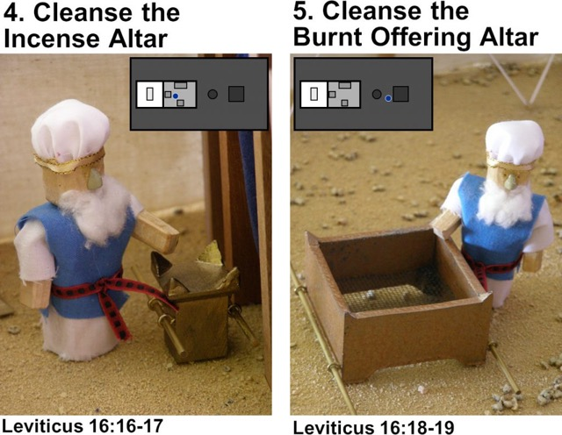
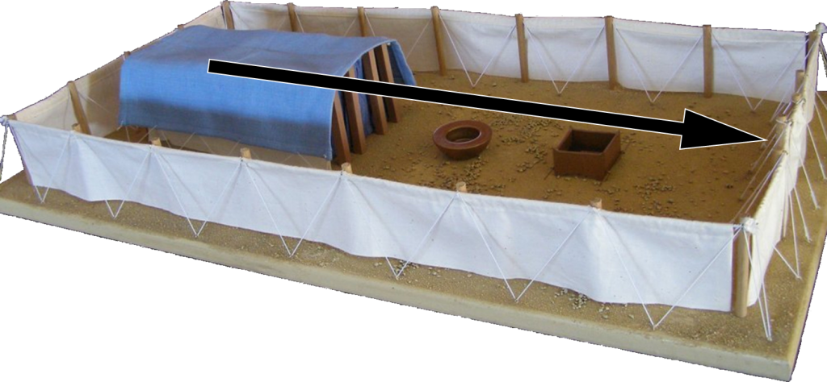

Slide 6
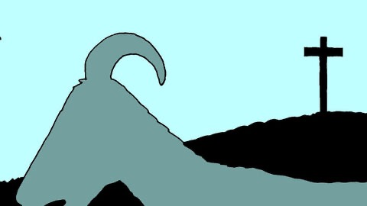
Jesus is the Lamb Goat of God -

