Slide 1
In Hebrew the
Festival of Unleavened Bread is called Chag HaMatzot

Slide 2
Feast of the Passover
Remembering the deliverance of the Israelites from Egypt
Chag HaMatzot
Feast of Unleavened Bread
Leaven = yeast
Chametz
All traces of any leaven or food made with leaven
Bedikat Chametz
The ceremony where the final crumbs of leaven are removed from the house, marking the start of the Feast of Unleavened Bread
Nisan 14/15
Feast of the Passover
Nisan 15-22
Feast of Unleavened Bread
Matzah
Bread made without leaven

Slide 3
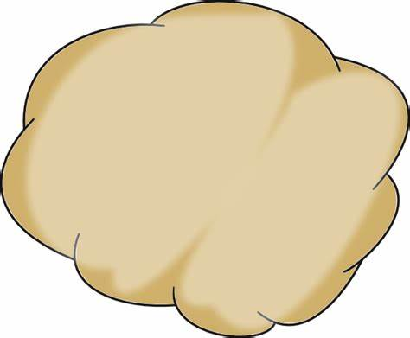
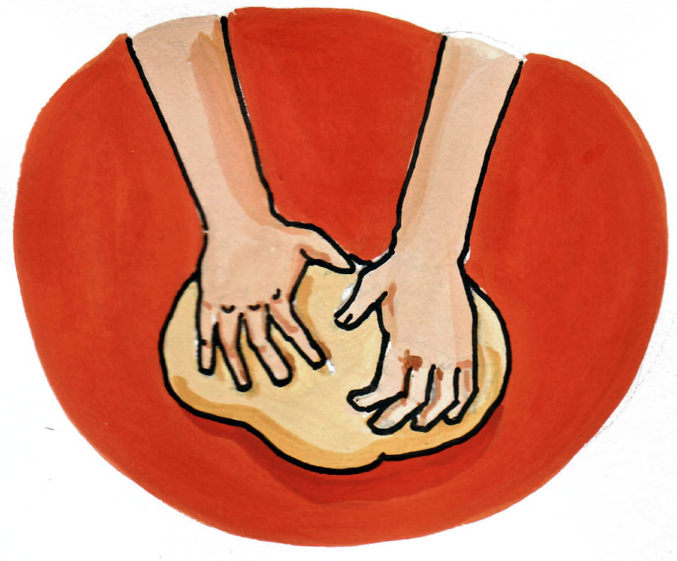
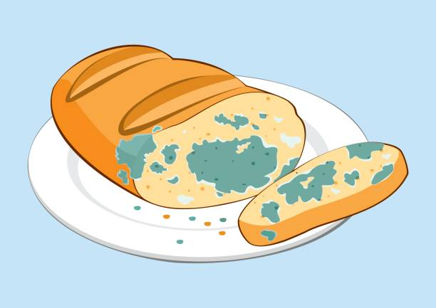
Breadmaking in ancient Israel
Small piece of old dough containing leaven (yeast) is added to the new dough to make it rise.
But the old dough also contains bacteria (from the air, people’s hands etc) which cause the new dough, over time, to decay.
So the leaven (Chametz) was associated with death and corruption.

Slide 4
Chametz
All traces of any leaven or food made with leaven
Chametz is a symbol of how sin corrupts the human soul
God commands His people to ‘put away’ sin, distancing themselves from it
Matzah
Bread made without leaven
Matzah is a symbol of purity
It’s the ‘bread of our affliction’ (affliction = sin). By removing the leaven, Matzah is the reminder that God removed the Israelites from their ‘old life’ of slavery

Slide 5
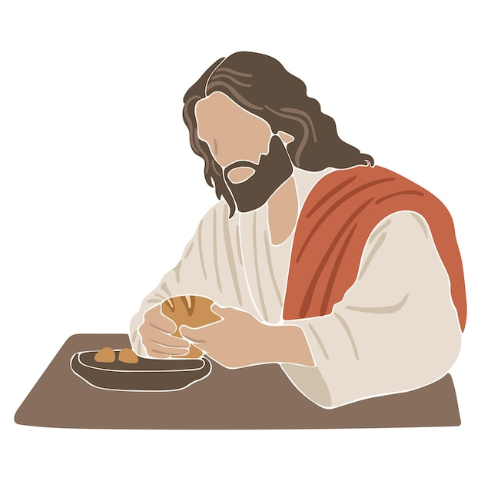
Jesus and The Feast of Unleavened Bread
Jesus links His body to the Matzah bread because:
He is free from corruption
He will be ‘broken’ on the cross
He is the only way humans can be delivered into a new life with God
He is both the Passover Lamb and the ‘bread of our affliction’ (taking the punishment that our sins deserve)
‘This is my body, broken for you.’
Matzah
Bread made without leaven

Slide 6
Jesus, The Feast of Unleavened Bread….and us
Without Jesus we are
Enslaved to the ‘old way’ of life, which leads to death
Contaminated by (the ‘leaven’ of) our sins
Through Jesus we are
A new creation!
Purified through His uncorrupted (unleavened) life, broken (given) for us
‘This is my body, broken for you.’

Slide 7
Jesus, The Feast of Unleavened Bread….and us
They asked: How should we live?
Jesus said: Love God and love your neighbour (Mark 12:28-34)
Discipleship
Sanctification: A life devoted to ‘putting away’ the leaven of sin, empowered by the Holy Spirit
Confession: A regular ‘Bedikat Chametz’ ceremony, ridding the house (our body, heart, mind) of the leaven of sin
Loving challenge: Encouraging (cheering one another on) our fellow Christians in this task
Evangelism
Point to Jesus
Trust that the Holy Spirit will convict, in God’s timing
The leaven of sin will be removed gradually, and it’s not linear!
Is it a sin? Is it stopping us from loving God or our neighbour?
Above all, love!

Slide 8
