Slide 1
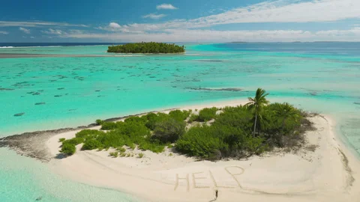

Slide 2
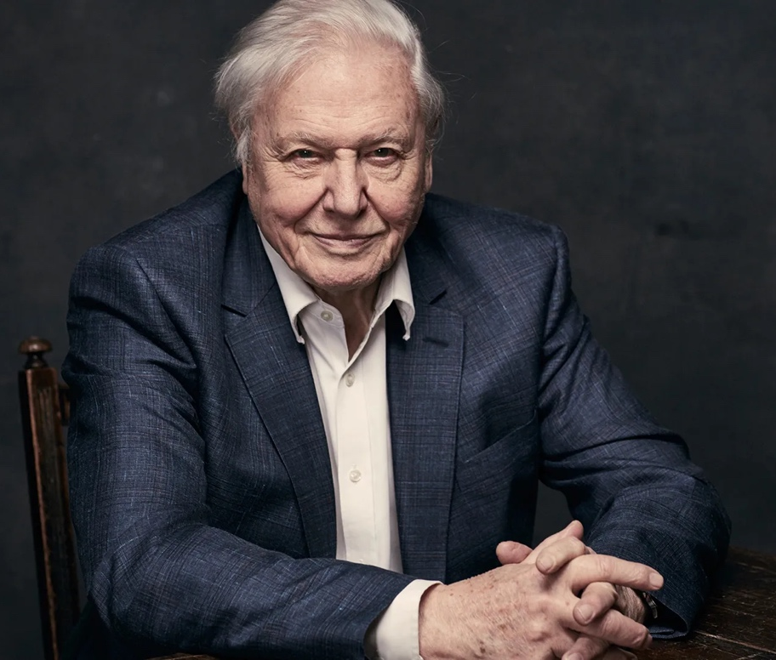
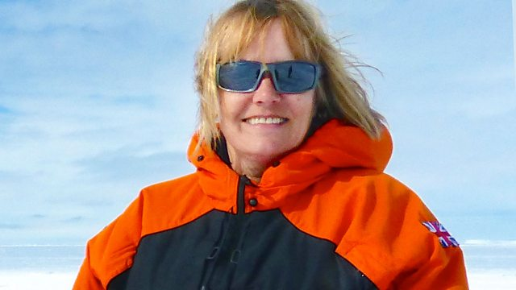
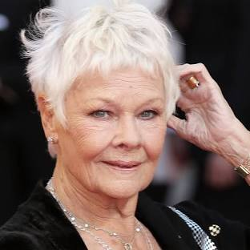
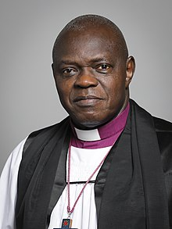
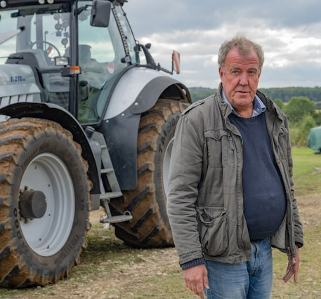
B – DAME JANET FRANCIS DIRECTOR OF BRITISH ANTARCTIC SURVEY
A – DAVID ATTENBOROUGH
D- DAME JUDY DENCH
LUXURY ITEMS TO MATCH
1. A KITCHEN
2. CARDBOARD CUT OUTS OF FRIENDS AND FAMILY
3. PIANO (TO BE USED AS A BOAT IF NEEDED)
4. A JET SKI
5. AN ENDLESS SUPPLY OF HORSERADISH SAUCE
C- JEREMY CLARKSON
E - JOHN SENTAMU

Slide 3
LUXURY ITEMS TO MATCH
1. A KITCHEN
2. CARDBOARD CUT OUTS OF FRIENDS AND FAMILY
3. PIANO (TO BE USED AS A BOAT IF NEEDED)
4. A JET SKI
5. AN ENDLESS SUPPLY OF HORSERADISH SAUCE
E - JOHN SENTAMU
D- DAME JUDY DENCH
A – DAVID ATTENBOROUGH
C- JEREMY CLARKSON
B – DAME JANET FRANCIS DIRECTOR OF BRITISH ANTARCTIC SURVEY

Slide 4
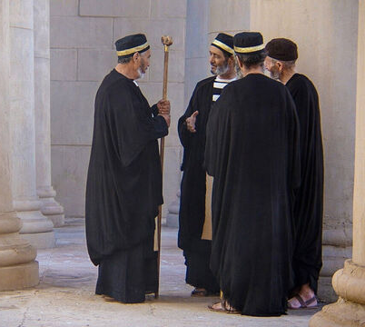
BEWARE OF THE SELF-SERVING SCRIBES

Slide 5
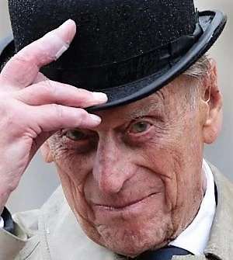
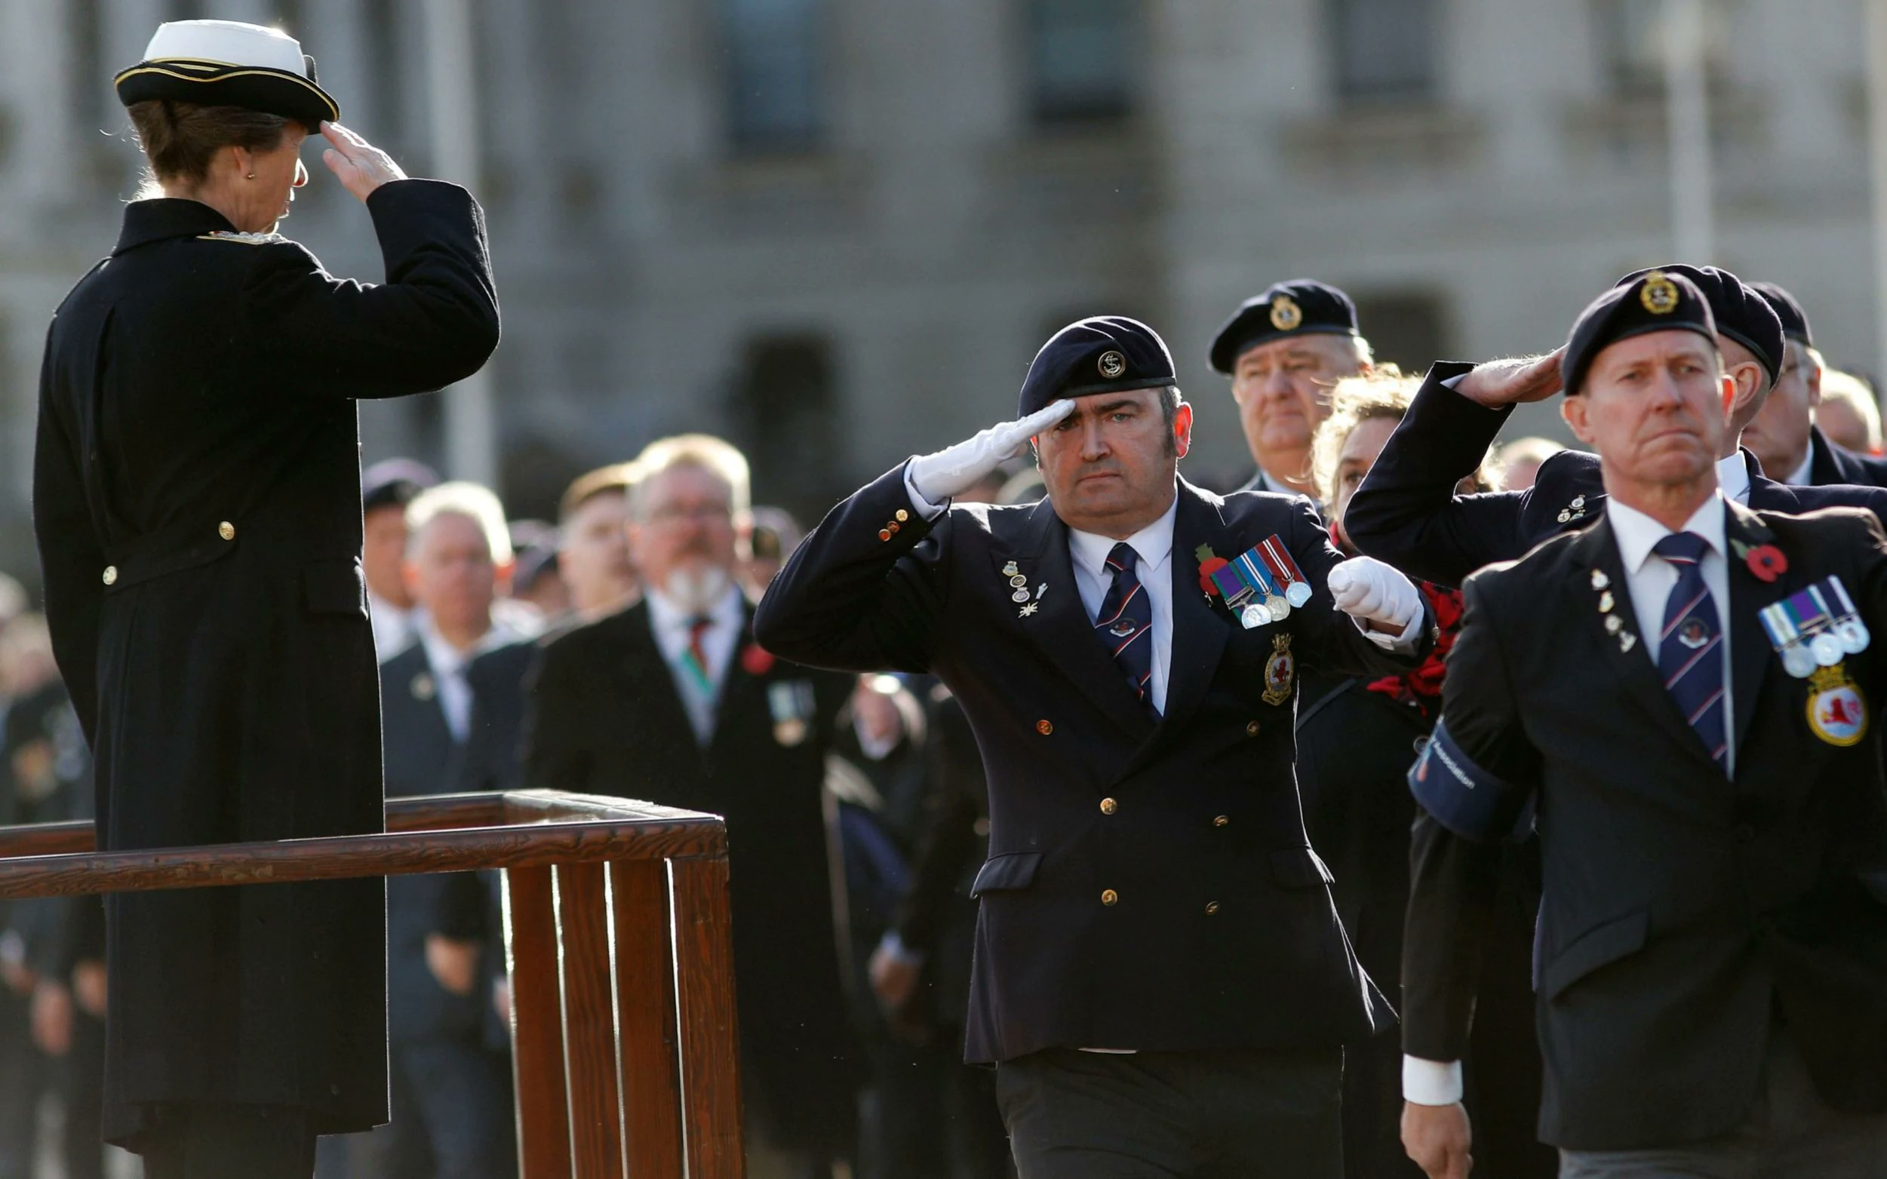
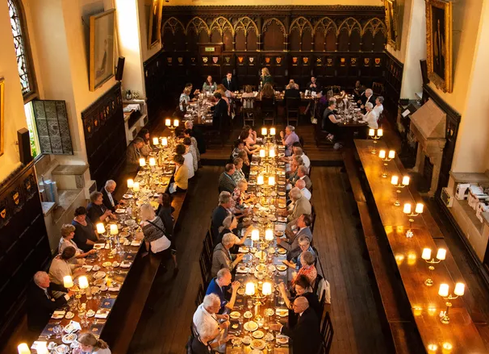
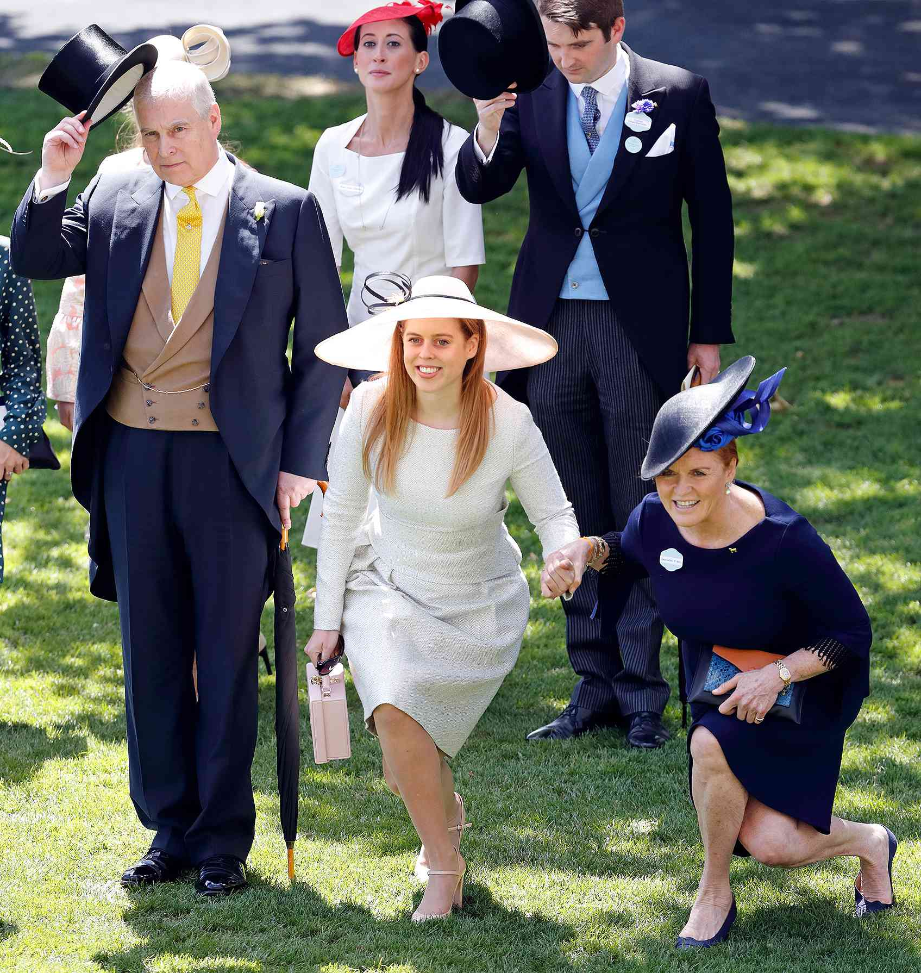

Slide 6
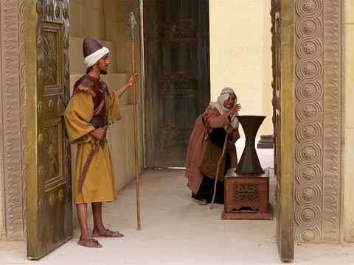
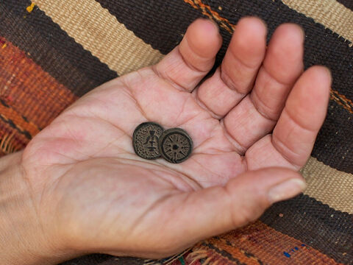
WONDER AT THE
SELF-SACRIFICIAL WIDOW

Slide 7
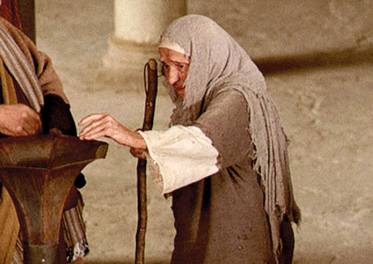
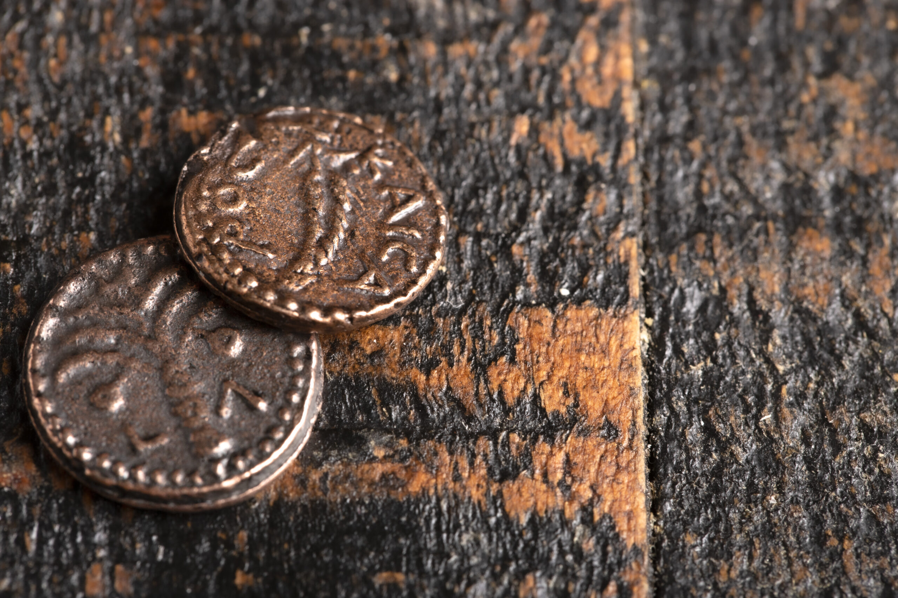
2.
CHECK
1.
LOOK
SEE
3.
SELF SERVING OR SELF SACRIFICAL?

